Slide 1
Decoupling Workflow From Forms
Using an Application Controller, IoC Container, Event Aggregator, and Command pattern
Presented By:
Derick Bailey
Copyright 2009 McLane Advanced Technologies, LLC

Slide 2

Topics Of This Presentation
Topics Covered
Event Aggregator
Command Pattern
Application Controller
Wiring Together With IoC Container
Goals
Object Oriented System
Testability
Flexibility
Maintainability (Ease of Enhancement)

Slide 3
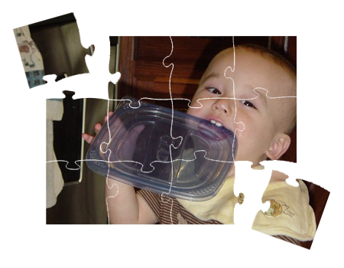
Object Oriented Principles
Cohesion:
“A measure of how strongly-related and focused the various responsibilities of a software module are” - Wikipedia

Slide 4
Object Oriented Principles
Encapsulation:
“The hiding of design decisions in a computer program that are most likely to change” - Wikipedia
?

Slide 5
Object Oriented Principles
Coupling:
“The degree to which each program module relies on each one of the other modules” – Wikipedia

Slide 6

Simple Org Chart
The Sample Application

Slide 7
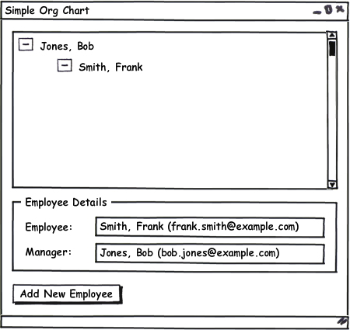
Simple Org Chart
The Main Form

Slide 8
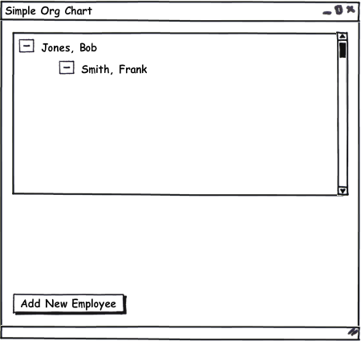
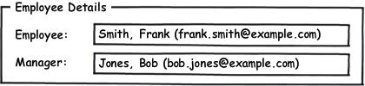
Simple Org Chart
The Main Form’s Parts

Slide 9
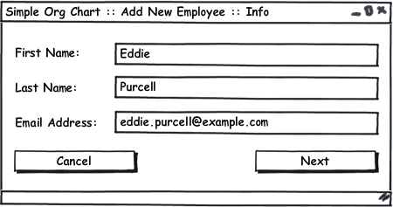
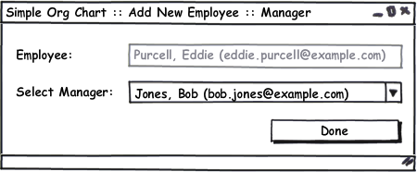
Simple Org Chart
Add New Employee Workflow

Slide 10
Simple Org Chart: Version 1
Tightly coupled forms: It works, but it doesn’t modify easily.

Slide 11
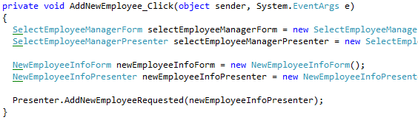
Simple Org Chart – v1
Tightly Coupled Workflow: Parent Form Knows About Children Forms, Presenters, and More!

Slide 12
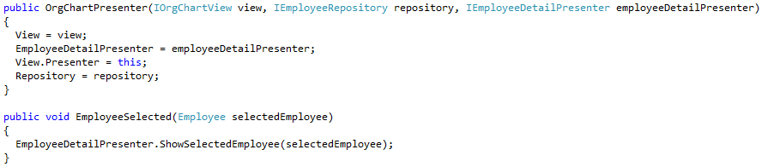
Simple Org Chart – v1
Tightly Coupled Presentation Logic: One Presenter Knows About Another

Slide 13
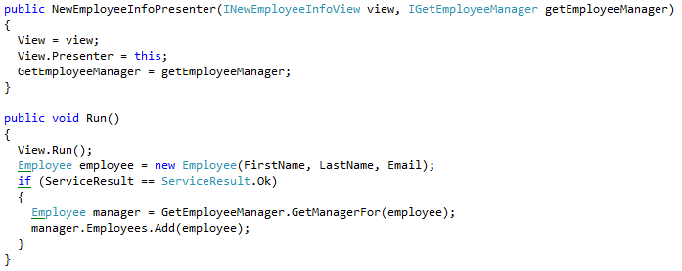
Simple Org Chart – v1
Tightly Coupled Workflow Logic: One Presenter Knows About Another

Slide 14
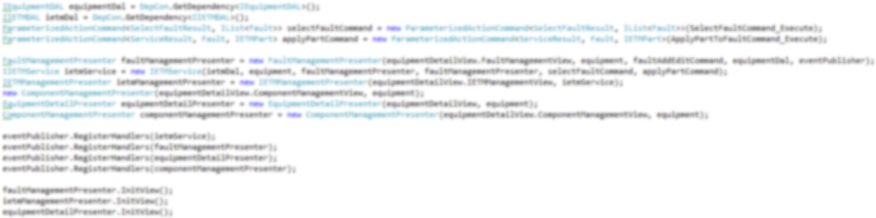

Simple Org Chart – v1
The Real World: How Bad The Coupling Can Get
1 Button
=
1 Button
=
1 Button
=
1 Button
=

Slide 15
Simple Org Chart Version 2
Introducing A Workflow Service

Slide 16
Workflow Services

Slide 17
Simple Org Chart Version 3
Introducing The Command Pattern

Slide 18
The Command Pattern
The command pattern is “used to represent and encapsulate all the information needed to call a method at a later time.” - Wikipedia
Invoked
Command
Invoker

Slide 19
The Command Pattern
Different Command Implementations In .NET
Delegates
Objects & Interfaces
Commands
Lambda Expressions
Anonymous Delegates

Slide 20
The Command Pattern
Interfaces And Objects
ICommand<T>
.Execute(T)
+
CommandDataType
=
CommandObject: ICommand<CommandDataType>
.Execute(CommandDataType param)
{
//do something here
}

Slide 21
Simple Org Chart – v2
Decoupling The Add New Employee Workflow From The Main Form
(Insert Command Interface And Object, Here)

Slide 23
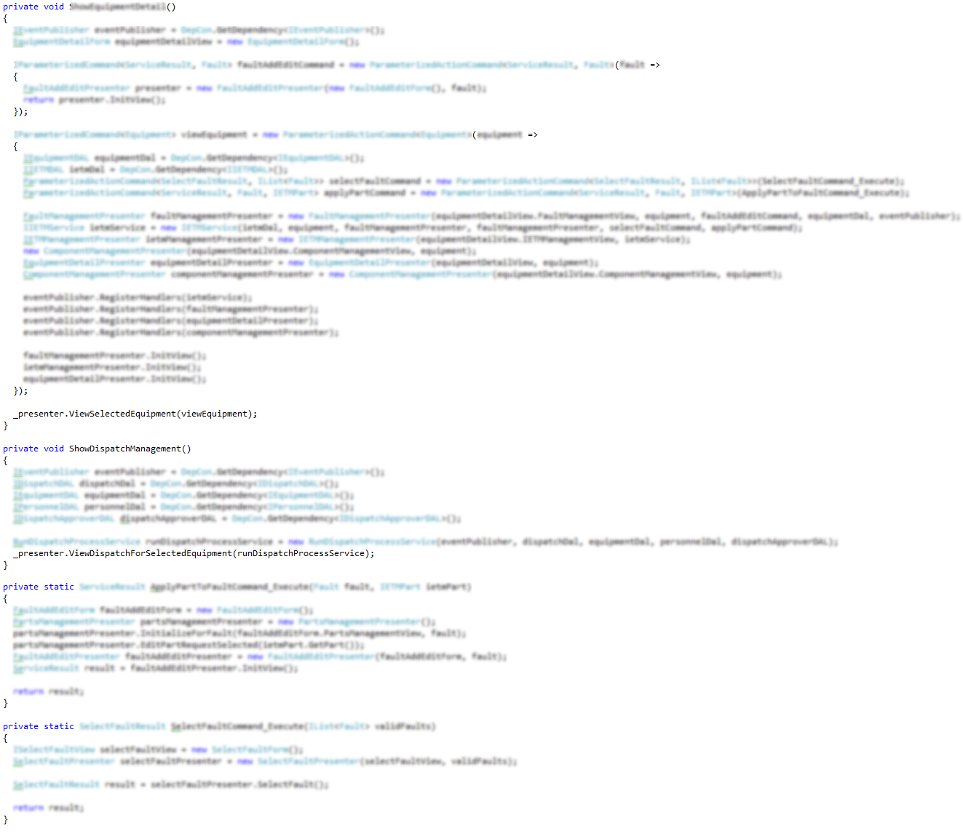
Simple Org Chart – v2
Workflow Coupling With ICommand

Slide 24
Simple Org Chart Version 4
Introducing An Event Aggregator

Slide 27
Simple Org Chart – Final Version
Orchestration With An Application Controller And IoC Container

Slide 30
Additional Resources
Command Pattern
http://www.lostechies.com/blogs/derickbailey/archive/2008/11/19/ptom-command-and-conquer-your-ui-coupling-problems.aspx
Event Aggregator http://www.martinfowler.com/eaaDev/EventAggregator.html
IoC Container (StructureMap)
http://structuremap.sourceforge.net
Application Controller
http://www.martinfowler.com/eaaCatalog/applicationController.html

Slide 31
About Me… Derick Bailey
Sr. Software Engineer and Architect @ McLane Advanced Technologies
Blog: derickbailey.lostechies.com
Email: derick.bailey@mclaneat.com derick@derickbailey.com
Twitter: @derickbailey
www.mclaneat.com
McLane Advanced Technologies
4001 Central Pointe Parkway
Temple, Texas 76504
800-988-5428
Copyright 2008 McLane Advanced Technologies, LLC

